Slide 1
MS&E 273
School of Engineering, Stanford University
Fall 2014, 3-4 units
Tuesdays, 4:15 – 7:15 PM,
Yang & Yamazaki Bldg Y2E2, Room 111
Professors
Audrey MacLean, Mike Lyons, Jack Fuchs
TAs
Francois Chaubard & Michael Heinrich

Slide 2
Technology • Venture • Formation
Tech Based
InfoTech
CleanTech
MedTech
BioTech
Venture Scale
Significant Problem
Significant Market
Significant Returns
Early Stage
Initial Funding
Product Development
Customer Discovery
Launch Phase
Escape Velocity
Notes:
Highlighting what we mean by Technology Innovation, what it means to be Venture Scale, and that we focus on the Early stage (i.e. Formation) of the company.

Slide 3
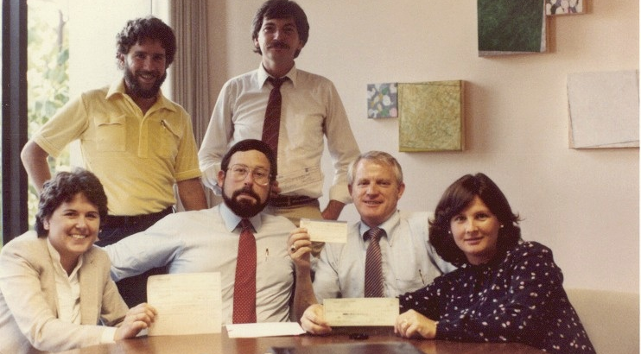
A Start-up Story
Notes:
Use this slide to insert a compelling story that illustrates what our class is all about. Need to brainstorm around this more.

Slide 4










Recent Success Stories
Notes:
Could use more “Alumni Careers” logos

Slide 5
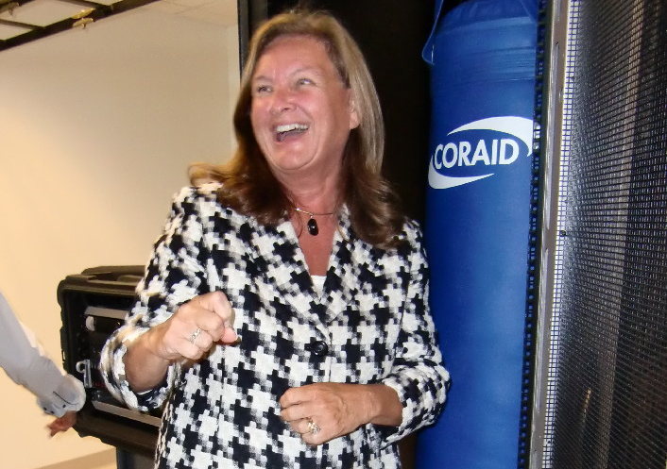
Start-up Conditioning
Notes:
Use this slide to insert a compelling story that illustrates what our class is all about. Need to brainstorm around this more.

Slide 6
10 Short Weeks
Form a Team
Come Up with an Idea
Assess the Opportunity
Create a Plan
Present it to real VCs

Slide 7
Technology Venture Formation
Why do you want to take
this course?
Notes:
Use as a placeholder to ask the class for feedback on what they want to get out of it.

Slide 8
Venture Capital Investment in Technology
2014 (Q1/Q2) US
$22.6B invested
2,099 deals
~$11M average deal size
National Venture Capital Association, PWC

Slide 9
US High-Tech IPOs and M&A
2014 (Q1/Q2)
125 M&A, $52B
37 IPO, $6.6B
Top Tech IPOs 2014
Twitter ($1.8B)
JD ($1.7B)
Sabre ($627M)
CommScope ($576M)
King Digital ($499M)
GoPro ($427M)
FireEye ($303M)
Zulily ($253M)
Deal Value ($ millions)
Renaissance Capital IPO ; PWC Technology Deal Insights
Notes:
second half of 2013 is projected
Need printout of date of IPOs

Slide 10
Investment Stage Q1 and Q2 2014
PWC MoneyTree

Slide 11
Testimonials
“This class alone made coming to Stanford worth it!”
Notes:
Use each quote for emphasis and highlight a few of the best ones

Slide 12
Testimonials
“MS&E 273 is hands down the best way to learn what life in a startup is like…This was the most useful class I took throughout my two years at Stanford…I'm putting learning into action by pursuing my own startup.”

Slide 13
Testimonials
“Beyond the tangible advice or skills learned, my biggest takeaway from the class was the impetus to stop talking about an idea and actually take steps to execute.”
Notes:
This leads to a discussion of learning the real skills to form a start-up

Slide 14
Course Objective
Transform a technology idea into a compelling venture scale business opportunity.
Notes:
Boiled down to one sentence

Slide 15
Course Outline
Market Plan
Opportunity Assessment
Product Development Plan
Product Validation
Hardware/ Software/Mobile Development
Med/BioTech Concerns
IP Strategy
VC Financing
Multistage Financing
Term Sheets
Capitalization
Customer Discovery
Go to Market
Competitive Differentiation
Financial Operating Plan
Notes:
As a timeline

Slide 16
Tech Venture Formation Eco-system
The Entrepreneur
Teaching Team
Mentors
Office Hours
Contacts/Connections
Stanford/STVP
Silicon Valley
CEO, CTO, CFO,CMO
Team

Slide 17
Admission
48 students accepted
Early admissions: 23
Spots left: 25
Admission and waitlist posted tonight, 11:59 pm
12 teams of 4 students formed by Thursday!
Admission requires forming a team of 4

Slide 18
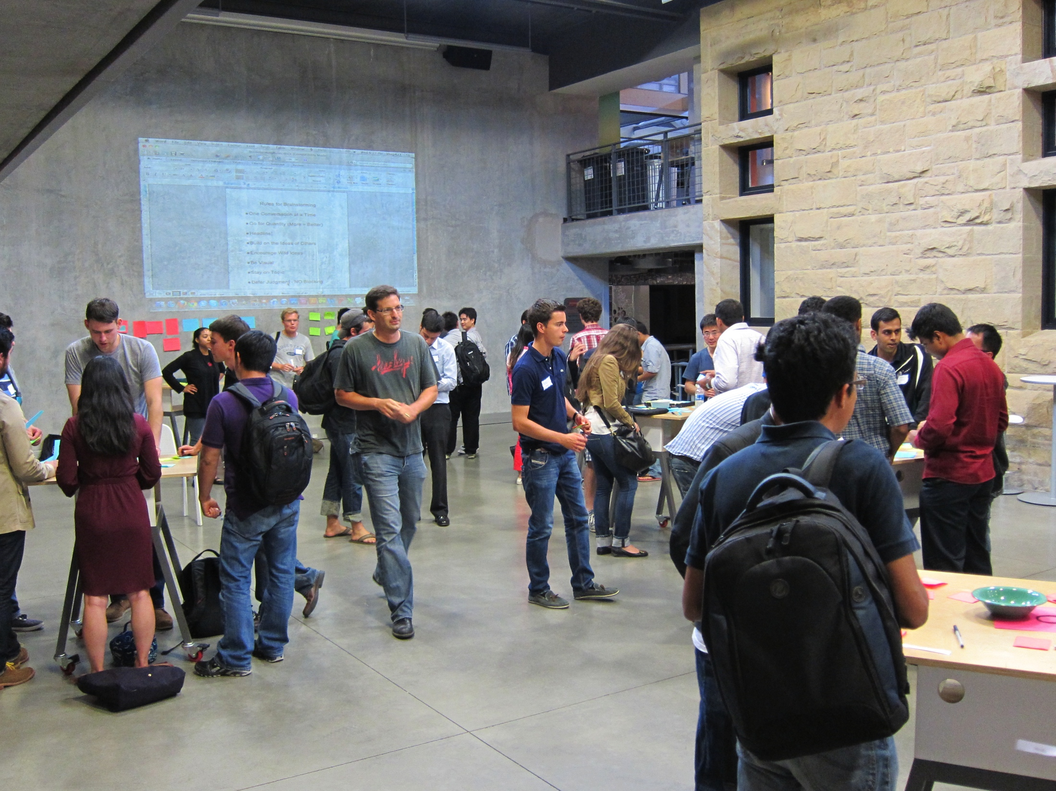
Forming Your Team – Wed. 5:30pm d.school atrium
Session 1: Brainstorming
"The brainstorming session was one of the most stimulating and exciting two-hour periods I've experienced in a very long time.”

Slide 19
Forming Your Team, Thurs. 6pm Y2E2 111 (here)
Session 2: Pitch Night
Partially formed teams or singles can pitch
Called in Alphabetical Order to pitch. Be ready!
Waitlisted folks allowed to participate
Come ready to pitch your ideas!!!

Slide 20
Supporting Entrepreneurs
Each team will be assigned mentors
Teaching team will hold weekly office hours
Instructors: Tuesday by sign-up, 2-3pm
TAs: Thursday by sign-up, 4-5pm
Mahesh Bhatia Office hours: Friday by sign-up, 2-3pm

Slide 21
Roadmap
WEEK 1 | Opportunity Assessment
 | Team Selection, Initial Concept, Mentor
WEEK 2 | Customer Discovery
 |  | Pitch Video, Concept Sign-off, October 3, Fri
WEEK 3 | Go to Market Plan
 | GATE I: Product/Market Fit – Saturday, October 11, Sat
WEEK 4 | Financial Operating Plan
WEEK 5 | Product Development Plan
Notes:
explain gate 1

Slide 22
Roadmap
WEEK 6 | VC Financing
 | GATE II – Saturday, Nov 1, Sat
WEEK 7 | Capitalization & Equity
WEEK 8 | The Big Picture: Business Model Analysis & VC Pitching
 | Business Model Analysis – Friday Nov 21 at Noon
Thanksgiving
WEEK 9 | Entrepreneurship – An Extreme Sport
WEEK 10 | Final VC Presentations
 | Dry runs Dec. 2 & 3 -- Final VC Presentations – Dec. 4 & 5

Slide 23
Getting to the Finish Line
Weekly assignments – Results reviewed in class
Gate I: Product/Market Presentation
Sat, October 11th (CTO/CMO)
Gate II: Financials/Business Model Presentation
Sat, November 1st (CFO/CEO)
Written Business Model Analysis
Due Friday, November 21st 12 noon
Final VC Presentations
Thursday, December 4th - Dry Run Tuesday December 2nd
Friday, December 5th - Dry Run Wednesday December 3rd

Slide 24
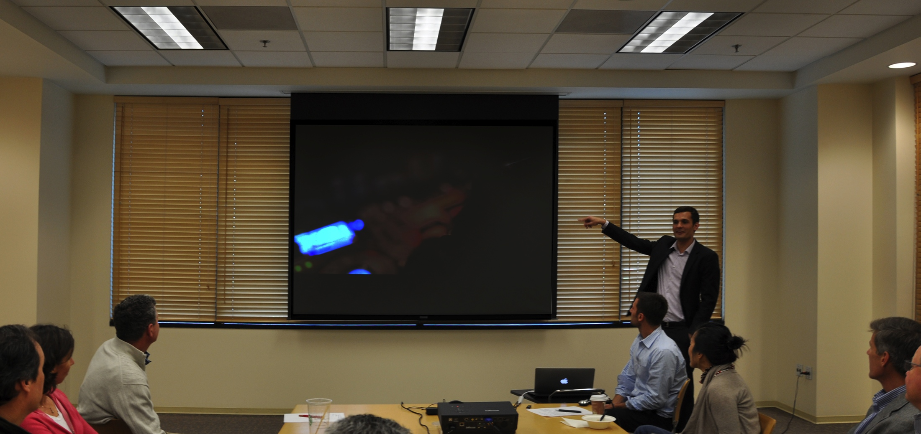
Final VC Presentation
Photo from final VC presentation

Slide 25
Grading
Deliverables
Participation, Assignments, Gates I & II | 25%
Written Business Model Analysis | 25%
Final Presentation to VC Panel | 50%

Slide 26
Expectations
Commitment + Intensity = Reward
100% commitment:
Attend lecture, Office Hours and Mentor meetings
Get out of the building. Make this part of your life, not just a class for a grade.
Intensity:
Sprint to the finish line each week!
Reward: Your team has the chance to deliver a compelling business opportunity to real VCs!

Slide 27
MS&E 273 Alumni
Michael Feng 2011, Co-Founder & CEO Docmunch
mike@docmunch.com
Beyang Liu 2012, Co-Founder & CEO Sourcegraph
Stanford MS in CS, 2013
beyang@sourcegraph.com

Slide 28
MS&E 273 Technology Venture Formation
If you have not completed an application, please fill this out online!
bit.ly/TVF_FallApplication
Final admission decisions will be made immediately after class.
Attendance: Please sign up at
bit.ly/intro273

Slide 29
Opportunity Assessment

Slide 30
What is Entrepreneurship?
“The Pursuit of Opportunity Without Regard to Resources Controlled”
Howard Stevenson
Harvard Business School

Slide 31
What’s an Opportunity?
A product or service around which you can build a profitable company and net a positive return to investors.

Slide 32
What's an Assessment?
A quick way for you to evaluate whether your opportunity is worth spending years of time and money on.

Slide 33
What is the need you are trying to satisfy?
Clearly define the need you are trying to satisfy, who the customer is and what drives the need. Figure out how they are solving the problem today and how big a pain point it is.

Slide 34
What is the potential market size?
Size up the market, know the growth projections and incumbents’ shares of the market, determine market share that you can acquire.

Slide 35
What is your competitive advantage?
Scope out the competitive landscape and identify your competitive advantages (Technology, IP, channel innovation etc.). Understand how disruptive your innovation is and how sustainable your competitive advantage will be.

Slide 36
Opportunity ID – The 5 Filters
Burning
Need
Big Enough
Opportunity
Scalable Business Model
Sustainable Differentiated Positioning
Why us?
Why now?
1
2
3
4
5

Slide 37
How do we get started?

Slide 38
Where are Opportunities Born?
Technology shifts
Moore’s Law
Disruptive technology
Market changes
Value chain disruption/obsolescence
Deregulation
Societal changes
Changes in how we live, learn, work (internet).
The world is flat (outsourcing)
Notes:
Ideas to add--
Technology Shifts: mobile/local/geo, big data, real time analytics,
Market changes: sector deregulation (health, energy, crowdsourcing), H1B Visas, BitCoin/Alternative currency
Societal Changes: bias toward sharing, collaborative consumption,

Slide 39
Idea/Opportunity Brainstorming
All ideas/opportunities are welcome
But you are Stanford Engineers - start with an engineering idea!
Use your RESEARCH; you have an inherent advantage!
There are no “dumb” ideas so go off on tangents
Each idea gets deeply explored, tossed or morphed
Analyze strengths, weaknesses, opportunities, competitive threats

Slide 40
The power of exponential growth …
Disruptive technologies create exponential growth
Exponential
Linear

Slide 41

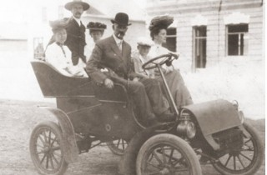
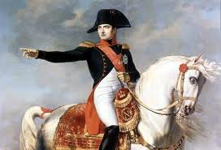
…looks different at its infancy
“The Americans have need of the telephone, but we do not. We have plenty of messenger boys.” — Chief Engineer, British Post Office, 1878
Linear
“Maybe
For Others”
“The horse is here to stay but the automobile is only a novelty – a fad.” — The president of Michigan Savings Bank advising not to invest in the Ford Motor Co., 1903
“Fad”
Pre-Exponential
“How, sir, would you make a ship sail against the wind and currents by lighting a bonfire under her deck? I pray you, excuse me, I have not the time to listen to such nonsense.” — Napoleon Bonaparte, when told of Robert Fulton’s steamboat, 1800s
“Wont’ Work”

Slide 42
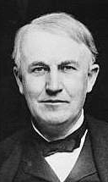
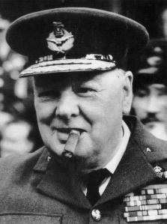

The difficulties look insurmountable
“It is apparent to me that the possibilities of the aeroplane, which two or three years ago were thought to hold the solution to the [flying machine] problem, have been exhausted, and that we must turn elsewhere.” — Thomas Edison, American inventor, 1895
“Atomic energy might be as good as our present-day explosives, but it is unlikely to produce anything very much more dangerous.” — Winston Churchill, then First Lord of the Admiralty, 1939
“This ‘telephone’ has too many shortcomings to be seriously considered as a means of communication. The device is inherently of no value to us.” — A Western Union memo, 1876/8

Slide 43
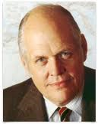


The potential impact looks marginal
“There is no reason anyone would want a computer in their home.” — Ken Olson, founder of Digital Equipment Corp. (DEC), maker of mainframe computers, arguing against the PC, 1977
“The world potential market for copying machines is 5000 at most.” — IBM, to the eventual founders of Xerox, saying the photocopier did not have a market large enough to justify production, 1959
“There is practically no chance communications space satellites will be used to provide better telephone, telegraph, television, or radio service inside the United States.” — T. Craven, FCC Commissioner (USA), 1961

Slide 44
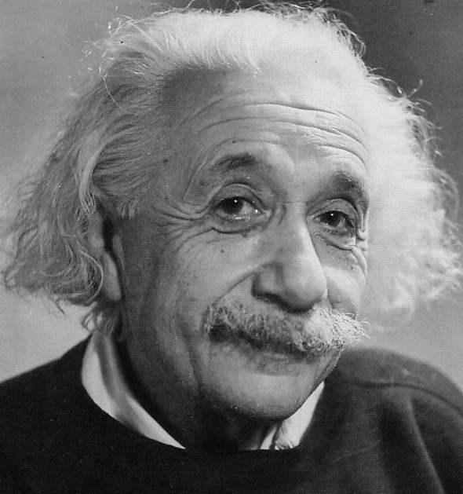
We need to look beyond ‘conventional wisdom’
“We can't solve problems by using the same kind of thinking we used when we created them.”

Slide 45

Innovation: The Attacker’s Advantage
Notes:
Different photo? Crossing the Chasm? Innovators Dilemma?

Slide 46
Brainstorming Guidelines
Key: Finding a Tech Venture Opportunity That Has Substantial Market Size
No Consulting Businesses
Leverage Your Own Experience/Expertise, e.g. research area, if possible
The More Relevant DNA on Team, the Better
Try to Find a Disruptive Business (Tech or Bus Model+Tech)
“Me Too” Doesn’t Work Well
Substantial Products May Take More Than 1 yr to Develop
Remember, You’ll Have to Explain the Whole Business at the end, Not Just do some “Customer Development”
Complex Products Usually Require Substantial Engineering Resources
Be Fearless: Dump Bad Ideas Quickly
Fast Iteration Now Pays Big Dividends Later

